Slide 1
Cloud Computing
The Basics

Slide 2
The Next Revolution in IT The Big Switch in IT
Classical Computing
Buy & Own
Hardware,
System Software,
Applications often to meet peak needs.
Install, Configure, Test, Verify
Manage
..
Finally, use it
$$$$....$(High CapEx)
Cloud Computing
Subscribe
Use
$ - pay for what you use, based on QoS
Every 18 months?

Slide 3
Cloud Computing
Definition…
Cloud Computing
The “Cloud” is the default symbol of the Internet in diagrams.
The broader term of “Computing” encompasses:
Computation
Coordination logic
Storage
Cloud Computing is about moving computing from the single desktop pc/data centers to commercial service providers on the Internet.

Slide 4
Cloud Computing
Essential characteristics:
On-demand self service
Broad network access
Resource pooling
Rapid elasticity
Measured service
Extras
Pay-per-use
SLA
Distribution

Slide 5
Definition:
In utility computing the hardware and software resources are concentrated in large data centers and users can pay as they consume computing, storage, and communication resources. Utility computing often requires a cloud-like infrastructure, but its focus is on the business model for providing the computing services.
Cloud computing is a path to utility computing embraced by major IT companies such as Amazon, Apple, Google, HP, IBM, Microsoft, Oracle, and others.
Cloud computing delivery models, deployment models, defining attributes, resources, and organization of the infrastructure discussed in this chapter are summarized in Figure 1.

Slide 6
Flexible resource assignment
The capacity and resources available to cloud computing services can be increased or decreased, with costs adjusted according to actual consumption.
This allows an organization to spin up a new offering with only minimal costs for the resources used and then to meet spikes or cyclic use patterns with increased capacity, paying for only the level of use needed.
This is similar to the way power companies supply power to individual organizations, billing each according to its individual use.
For example, a new cloud application might experience a sudden increase in use following mention on a popular blog and require additional network bandwidth, data storage, server memory, or CPU power to keep up with the sudden increase in demand.

Slide 7
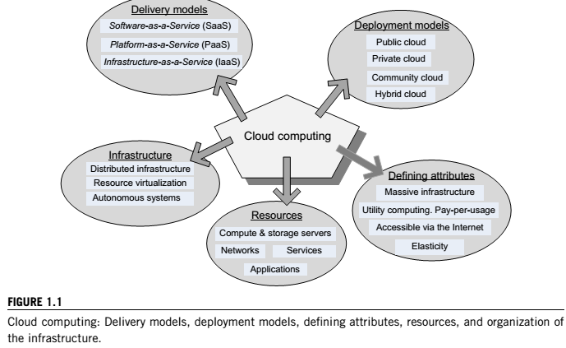

Slide 8
Defining attributes
Cloud computing uses Internet technologies to offer elastic services. The term elastic computing refers to the ability to dynamically acquire computing resources and support a variable workload. A cloud service provider maintains a massive infrastructure to support elastic services.
The resources used for these services can be metered and the users can be charged only for the resources they use.
Maintenance and security are ensured by service providers.
Economy of scale allows service providers to operate more efficiently due to specialization and centralization.
Cloud computing is cost-effective due to resource multiplexing; lower costs for the service provider are passed on to the cloud users.
The application data is stored closer to the site where it is used in a device- and location-independent manner; potentially, this data storage strategy increases reliability and security and, at the same time, it lowers communication costs.

Slide 9
A computing grid is a distributed system consisting of a large number of loosely coupled, heterogeneous, and geographically dispersed systems in different administrative domains.
The term computing grid is a metaphor for accessing computer power with similar ease as we access power provided by the electric grid.
The term content refers to any type or volume of media, be it static or dynamic, monolithic or modular, live or stored, produced by aggregation, or mixed. Information is the result of functions applied to content.

Slide 10
Types of cloud computing
Private cloud. The infrastructure is operated solely for an organization. It may be managed by the organization or a third party and may exist on or off the premises of the organization.
Community cloud. The infrastructure is shared by several organizations and supports a specific community that has shared concerns (e.g., mission, security requirements, policy, and compliance considerations). It may be managed by the organizations or a third party and may exist on premises or off premises.
Public cloud. The infrastructure is made available to the general public or a large industry group and is owned by an organization selling cloud services.
Hybrid cloud. The infrastructure is a composition of two or more clouds (private, community, or public) that remain unique entities but are bound together by standardized or proprietary technology that enables data and application portability (e.g., cloud bursting for load balancing between clouds)

Slide 11
Success of cloud computing
Cloud computing is in a better position to exploit recent advances in software, networking, storage, and processor technologies. Cloud computing is promoted by large IT companies where these new technological developments take place, and these companies have a vested interest in promoting the new technologies.
A cloud consists of a homogeneous set of hardware and software resources in a single administrative domain. In this setup, security, resource management, fault tolerance, and quality of service are less challenging than in a heterogeneous environment with resources in multiple administrative domains.
Cloud computing is focused on enterprise computing; its adoption by industrial organizations, financial institutions, healthcare organizations, and so on has a potentially huge impact on the economy.
A cloud provides the illusion of infinite computing resources; its elasticity frees application designers from the confinement of a single system.
A cloud eliminates the need for up-front financial commitment, and it is based on a pay-as-you-go approach. This has the potential to attract new applications and new users for existing applications, fomenting a new era of industry wide technological advancements.

Slide 12
Obstacles of Cloud Computing
Availability of Service: What happens when the service provider cannot deliver? Can a large company such as General Motors move its IT to the cloud and have assurances that its activity will not be negatively affected by cloud overload? A partial answer to this question is provided by service-level agreements (SLAs). A temporary fix with negative economical implications is overprovisioning, that is, having enough resources to satisfy the largest projected demand.
Vendor lock-in: Once a customer is hooked to one provider, it is hard to move to another. The standardization efforts at National Institute of Standards and Technology (NIST) attempt to address this problem.
Data confidentiality and auditability: This is indeed a serious problem.
Data transfer bottlenecks: Many applications are data-intensive. A very important strategy is to store the data as close as possible to the site where it is needed. Transferring 1 TB of data on a 1 Mbps network takes 8 million seconds, or about 10 days; it is faster and cheaper to use courier service and send data recoded on some media than to send it over the network. Very high-speed networks will alleviate this problem in the future; for example, a 1 Gbps network would reduce this time to 8,000 s, or slightly more than 2 h.

Slide 13
Obstacles of Cloud Computing
Performance unpredictability: This is one of the consequences of resource sharing.
Elasticity: the ability to scale up and down quickly. New algorithms for controlling resource allocation and workload placement are necessary. Autonomic computing based on self-organization and self management seems to be a promising avenue.
Software licensing and system bugs.

Slide 14
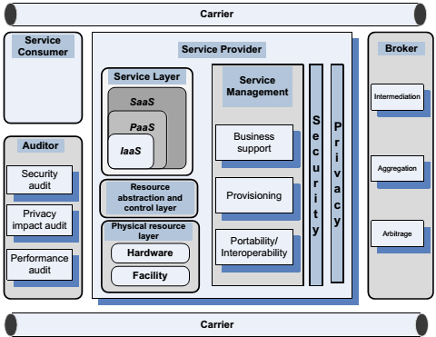
Cloud computing delivery models and services

Slide 15
Delivery models and Services
the entities involved in cloud computing are the service consumer,
the entity that maintains a business relationship with and uses service from service providers; the service provider,
the entity responsible for making a service available to service consumers; the carrier,
the intermediary that provides connectivity and transport of cloud services between providers and consumers; the broker,
an entity that manages the use, performance, and delivery of cloud services and negotiates relationships between providers and consumers; and the auditor, a party that can conduct independent assessment of cloud services, information system operations, performance, and security of the cloud implementation.
An audit is a systematic evaluation of a cloud system that measures how well it conforms to a set of established criteria.

Slide 16
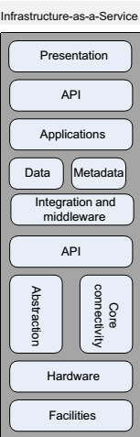
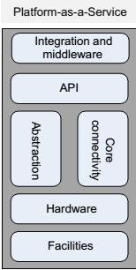
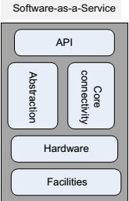
Three delivery models
SaaS gives users the capability to use applications supplied by the service provider but allows no control of the platform or the infrastructure.
PaaS gives the capability to deploy consumer-created or acquired applications using programming languages and tools supported by the provider.
IaaS allows the user to deploy and run arbitrary software, which can include operating systems and applications.

Slide 17
Software-as-a-Service(SaaS)
Software-as-a-Service(SaaS) gives the capability to use applications supplied by the service provider in a cloud infrastructure. The applications are accessible from various client devices through a thin-client interface such as a Web browser (e.g., Web-based email).
The user does not manage or control the underlying cloud infrastructure, including network, servers, operating systems, storage, or even individual application capabilities, with the possible exception of limited user-specific application configuration settings.
Services offered:
Enterprise services such as workflow management, groupware and collaborative, supply chain, communications, digital signature, customer relationship management (CRM), desktop software, financial management, geo-spatial, and search.
• Web 2.0 applications such as metadata management, social networking, blogs, wiki services, and portal services.

Slide 18
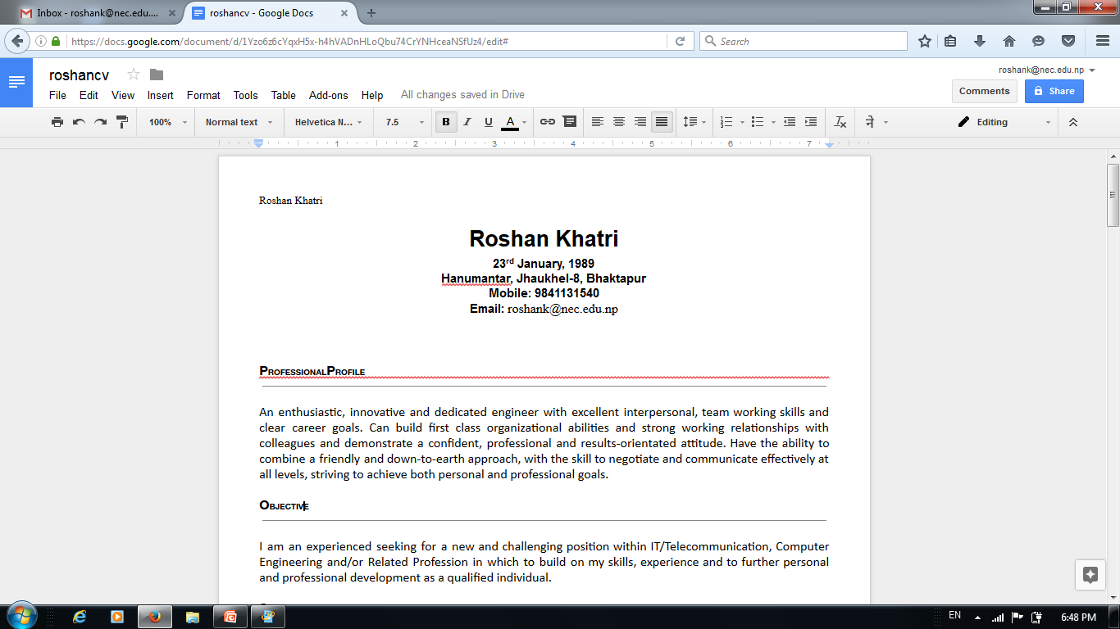
Google Docs SaaS

Slide 19
Platform-as-a-Service(PaaS)
Platform-as-a-Service(PaaS) gives the capability to deploy consumer-created or acquired applications using programming languages and tools supported by the provider.
Such services include session management, device integration, sandboxes, instrumentation and testing, contents management, knowledge management, and Universal Description, Discovery, and Integration (UDDI), a platform-independent Extensible Markup Language (XML)-based registry providing a mechanism to register and locate Web service applications.
PaaS is not particulary useful when the application must be portable, when proprietary programming languages are used, or when the underlaying hardware and software must be customized to improve the performance of the application.
The major PaaS application areas are in software development where multiple developers and users collaborate and the deployment and testing services should be automated.

Slide 20
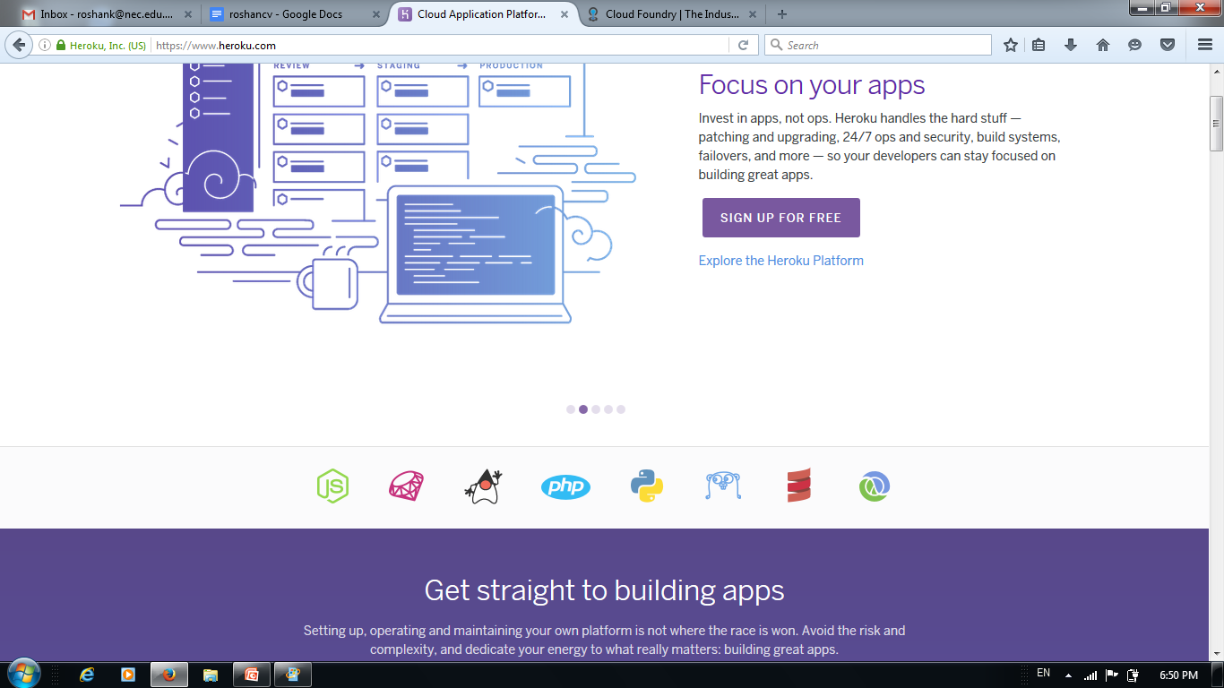
Heroku PaaS

Slide 21
Infrastructure-as-a-Service (IaaS)
Infrastructure-as-a-Service(IaaS) is the capability to provision processing, storage, networks, and other fundamental computing resources; the consumer is able to deploy and run arbitrary software, which can include operating systems and applications.
The consumer does not manage or control the underlying cloud infrastructure but has control over operating systems, storage, deployed applications, and possibly limited control of some networking components, such as host firewalls.
Services offered by this delivery model include: server hosting, Web servers, storage, computing hardware, operating systems, virtual instances, load balancing, Internet access, and bandwidth provisioning.

Slide 22
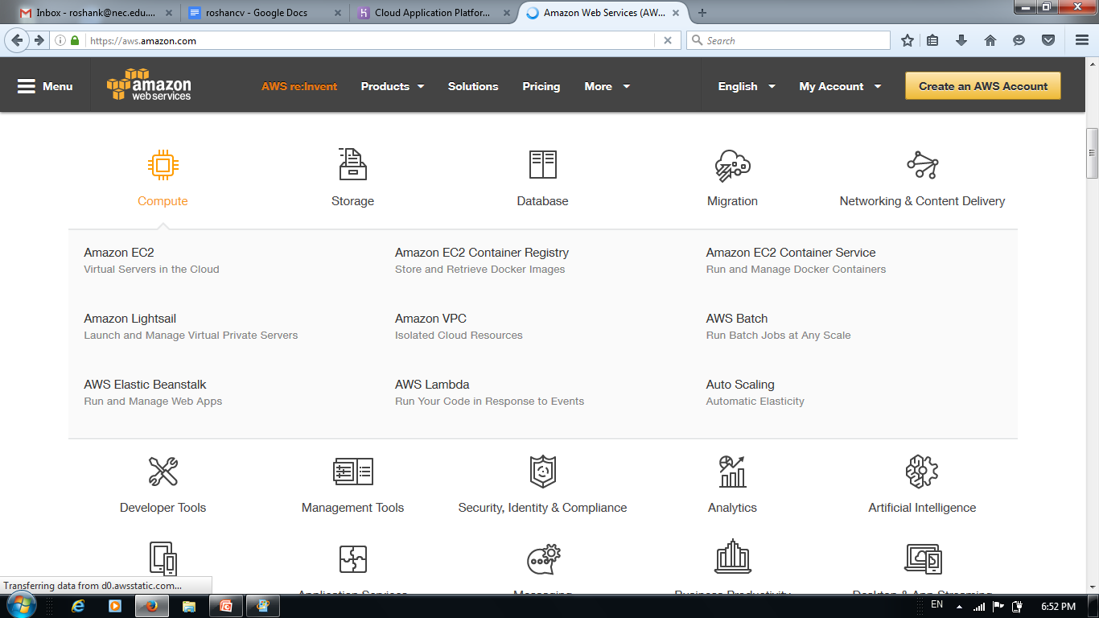
AWS IaaS

Slide 23
Defining Cloud Computing
cloud computing refers to flexible self-service, network-accessible computing resource pools that can be allocated to meet demand.
Services are flexible because the resources and processing power available to each can be adjusted on the fly to meet changes in need or based on configuration settings in an administrative interface, without the need for direct IT personnel involvement.
Cloud computing allows the allocation of resources to be adjusted as needed, creating a hardware-independent framework for future growth and development.

Slide 24
Clouds Hold More than Just Rain
Almost anything can be hosted in the cloud, from databases and applications to complete virtual infrastructures encompassing data storage, networking, and all components of the server environment.
The cloud can also host virtualized user desktop environments available from any networked client device, whether or not the client has sufficient local resources to host the virtualized desktop environment and its various applications.

Slide 25
Common Characteristics of Cloud Computing
Managed by the provider :
Once applications and services have been moved to external cloud computing, an organization no longer needs to worry about local data center issues regarding power, space, and cooling, and developers need only know whether their applications will be running on one cloud service platform or another.
for example, Amazon Elastic Compute Cloud (EC2) or Microsoft Azure without having to consider where the services or application resources will be located. Knowledge of individual hardware characteristics and capacity measures is no longer important to the organization.

Slide 26
Common Characteristics of Cloud Computing
Network accessible
Cloud services are available via networked devices and technologies, facilitating rapid access by mobile customers and remote office locations.
This provides an “anywhere, anytime” service model not possible in traditional data centers, where service downtime and local-area outages in power and networking can impact uptime.
Before a hurricane, for example, a cloud service provider could transfer operations from Florida to Washington transparently to the service consumer.

Slide 27
Common Characteristics of Cloud Computing
Sustainable
Because cloud providers can provision resources at need, it is possible to reduce power and cooling requirements during off-peak times, gaining economies of scale well beyond those available to single-tenanted hardware based data services, which must stay on waiting for later use.
The flexibility in cloud hosting location allows providers to shift operations without disruption to consumers. They can move data center activity north during summer months to save on cooling costs or transfer operations to areas with excess power production capability, such as Iceland.
Cloudy Skies Are “Greening” the Data Center
Cloud hosting supports green initiatives through the use of environmental cooling by transferring operations to cooler locations rather than requiring ever larger refrigerated air systems to meet summer heat increases, reducing an organization’s environmental footprint.

Slide 28
Common Characteristics of Cloud Computing
Managed through self-service on demand
After limits for resource availability are configured within the cloud provider’s systems, available resource capacity can be automatically expanded or managed by the client with minimal effort.
Bringing up a test server no longer requires access to the physical system, loading software, and configuring networking by hand; instead, the customer need only access their cloud provider and request a new resource allocation using the self-service user interface.

Slide 29
Understanding Distributed Application Design
Services such as eBay depend on distributed processing to integrate real-time bids with item availability and many other factors calculated and managed simultaneously across many systems.
No single system could handle the volume of transactions occurring simultaneously as items are placed for bid, bids are submitted, notifications for winning bids are transmitted, and the various other aspects of online real-time auctions are carried out.
In cloud computing environments, even the location and type of hardware supporting a software application can shift from moment to moment as additional capacity is allocated or services are transferred between cloud provider data centers.

Slide 30
Clouds Virtualize the Application Development Cycle
Application development in the cloud improves business agility to offer new services to customers by making services immediately available
with whatever resources turn out to be needed rather than via the traditional model of application development, prototyping, testing, and then rollout to production systems after procurement.

Slide 31
Resource Management Automation
Another key function underlying the success of cloud computing is the management of resources automatically.
When demand nears capacity, the cloud hosting software is able to identify need
It respond by adding resources up to predetermined levels based on an organization’s contractual limits or limits configured in the management software.
This protects application availability while also ensuring that attacks will not overrun an organization’s budget.

Slide 32
Clouds Help Deal with Botnets and Distributed Denial-of-Service Attacks
Cloud services protect an organization by simply scaling up resources to meet growing demands during an attack while also ensuring that attacks, such as botnet distributed denial of service attacks, will not overrun an organization’s resources
Botnets are collections of individual computers remotely controlled by the “bot herder” to perform tasks as directed. Most bots are standard personal computers located in people’s homes and businesses and infected with viruses and remote control software that lets the bot herder issue commands.
By commanding all of the individual bots to connect to a target server, the bot herder consumes all of the targeted server’s resources trying to handle the attack, preventing legitimate use.

Slide 33
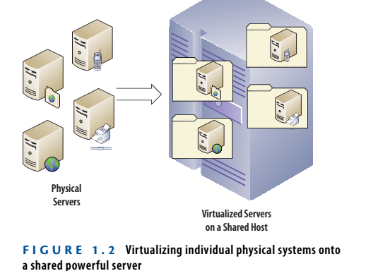
Virtualized Computing Environments
Cloud computing also makes extensive use of server virtualization to better utilize cloud hosting servers by allowing multiple systems to run on a more powerful server
This is referred to as multitenancy and allows system resources to be fully utilized before another server is brought online, further reducing operating costs and data center cooling requirements.

Slide 34
High-Performance Computing Models
Cloud computing also borrows from high-performance computing (HPC) techniques for separating individual procedures into multiple simultaneous processes that are sent out to individual computers, which then complete their portion of the final result.
Individual results are combined later to provide the complete final result, as illustrated in the digital animation example of Figure 1.3
The digital animation example shows how a complete animation can be broken down into smaller segments for concurrent rendering and then combined into the final product using grid computing technologies.

Slide 35
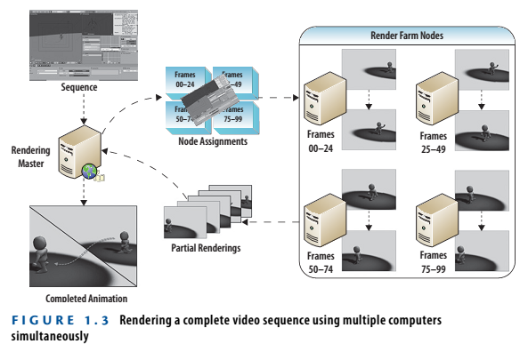

Slide 36
CPU chip manufacturers are developing new technologies that can also dedicate per-core resources to individual processes, like the Intel Many Integrated Core (Intel MIC) CPUs being developed for high-performance and cloud computing environments.

Slide 37
Cloud Computing Technologies
Workstations
The most common access client in an existing enterprise network will be the traditional thick client workstation system with a CPU, display device, and input devices (keyboard, mouse, trackball).
This type of client works equally well in cloud environments, accessing web applications and cloud resources through locally loaded applications and web browsers.
Servers:
Cloud backups provide another area in which traditional on-premise data centers can take advantage of the economies of scale and automatic resource allocation of cloud services to reduce costs for larger tape silos and expanded backup data storage.

Slide 38
Thin clients
Thin clients have only a very basic operating system, display device, and input devices but lack onboard storage for local applications.
They depend on remote software running on servers and so work very well with cloud services.
Mobile clients
Mobile devices from smartphones to tablets and constantly emerging variations are perfect clients for blending with cloud services.
These devices have sufficient onboard storage for rich user interface applications but limited CPU power and so rely on remote servers for the “heavy lifting” within data processing and analytics applications.

Slide 39

CHALLENGES
Challenge | Opportunity
Availability | Multiple providers
Data lock-in | Standardization
Data Confidentiality | Encryption, VLANs, Firewalls
Online storage service The Linkup closed August 8, 2008
- 20,000 paying subscribers lost their data
Coghead, a cloud vendor closed its business in Feb 19,2009
- Customers need to rewrite their applications

Slide 40
CHALLENGES
Challenge | Opportunity
Data transfer bottlenecks | FedEx-ing disks, reuse data multiple times
Performance unpredictability | Improved VM support, flash memory
Scalable storage | Invent scalable storage
Bugs in large distributed systems | Invent Debugger using Distributed VMs
Scaling quickly | Invent Auto-Scaler

Slide 41
Ethical issues in cloud computing
Reasons for Ethical Issues:
(i) the control is relinquished to third-party services;
(ii) the data is stored on multiple sites administered by several organizations; and
(iii) multiple services interoperate across the network.
Unauthorized access, data corruption, infrastructure failure, and service unavailability are some of the risks related to relinquishing the control to third-party services; it is difficult to identify the source and the entity causing it.
The complex structure of cloud services can make it difficult to determine who is responsible in case something undesirable happens. (“problem of many hands.”)

Slide 42
Proactive prevention for ethical issues
The need for rules and regulations for the governance of cloud computing is obvious. The term governance means the manner in which something is governed or regulated, the method of management, or the system of regulations.
Explicit attention to ethics must be paid by governmental organizations providing research funding for cloud computing; private companies are less constrained by ethics oversight and governance arrangements are more conducive to profit generation.
Accountability is a necessary ingredient of cloud computing; adequate information about how data is handled within the cloud and about allocation of responsibility are key elements for enforcing ethics rules in cloud computing.
Unwanted dependency on a cloud service provider, the so-called vendor lock-in, is a serious concern, and the current standardization efforts at NIST attempt to address this problem.

Slide 43
Cloud vulnerabilities
Clouds are affected by malicious attacks and failures of the infrastructure (e.g., power failures). Such events can affect Internet domain name servers and prevent access to a cloud or can directly affect the clouds.
For example, an attack at Akamai on June 15, 2004 caused a domain name outage and a major blackout that affected Google, Yahoo!, and many other sites. In May 2009 Google was the target of a serious denial-of-service (DoS) attack that took down services such Google News and Gmail for several days.
Lightning caused a prolonged downtime at Amazon on June 29 and 30, 2012; the AWS cloud in the Eastern region of the United States, which consists of 10 data centers across four availability zones, was initially troubled by utility power fluctuations, probably caused by an electrical storm.

Slide 44
Future of Cloud Computing
In a May 2008 report, Merrill Lynch estimated that 12% of the worldwide software market would go to the cloud in that period.
IBM said it would spend $360 million to build a cloud computing data center in Research Triangle Park, N.C., bringing to nine its total of cloud computing centers worldwide.
Dell CEO Michael Dell says. "Now it's a several-hundred-million-dollar business, and it will be a billion-dollar business in a couple of years—it's on a tear."
Microsoft, has made cloud computing one of five priorities for fiscal 2009, according to a recent memo from CEO Steve Ballmer.

